Slide 1
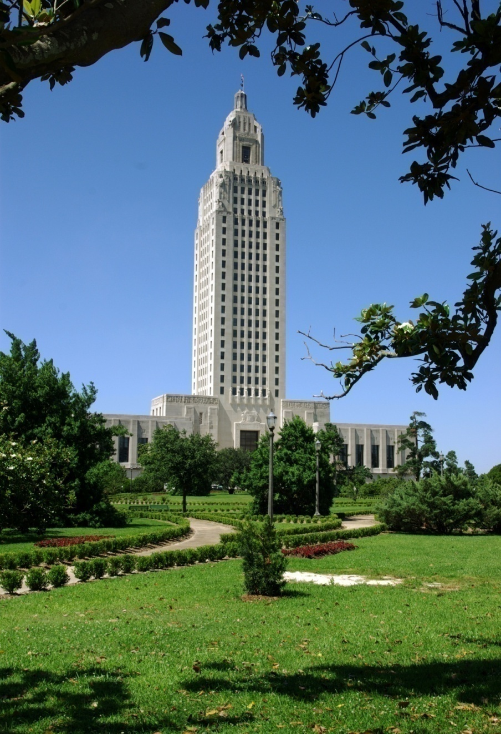
RESALE CERTIFICATE RENEWALS
Tax Administration Division Louisiana Department of Revenue Presented by Peggy Parker

Slide 2
The Louisiana Resale Certificate
(R-1064)
is issued to new taxpayers who indicate they are in the business of selling tangible personal property.
It is effective for 1 year from the date of issuance.

Slide 3
All resale certificates must be renewed through LaTAP, LDR’s Louisiana Taxpayer Access Point.
If the taxpayer does not have an account in LaTAP, they must set one up in order to renew the resale certificate.
There is no paper application for the resale certificate renewal.

Slide 4
WHEN DO I RENEW?
Businesses should apply for renewal within 60 days of expiration of the resale certificate.
Renewal requests before the 60 day renewal window will not be processed.
Notes:
If you try to renew too early, the request will be kicked out and you will have to reapply.

Slide 5
Information Needed for Renewal
• Account numbers for all locations
• Location and mailing addresses for all business locations
• NAICS code
• A valid e-mail address
• Amount of purchases for resale (cost of goods sold) for the last 2 years.
*If you are a consolidated filer, the cost of goods sold should consist of the combined purchases of all locations.
Notes:
NAICS stands for North American Industry Code System. Issued by IRS when requesting a federal employer identification number or when filing your first tax return. Louisiana Workforce Commission also issues them when a taxpayer applies for an account number with them. If not, check out the US Census Bureau web site and find one that closely matches your client’s business activity. Consolidated filers cost of goods sold should consist of the combined purchases of all members of the consolidation.

Slide 6
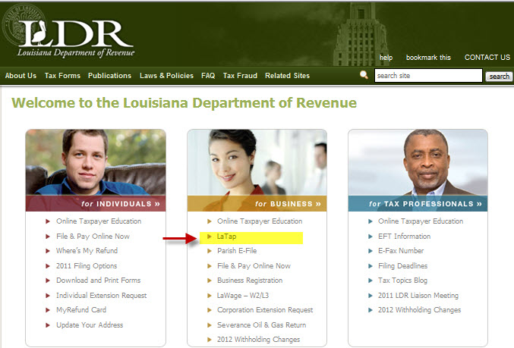
To begin:
On the LDR website at www.revenue.louisiana.gov, click on the LaTAP link to open the program.

Slide 7
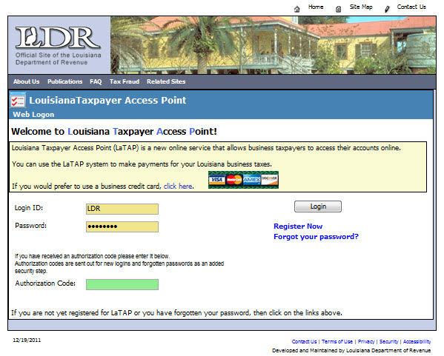
Enter your Login ID and Password and click the Login button or if you have not registered for LaTAP, click the Register Now link and follow the instructions.

Slide 8
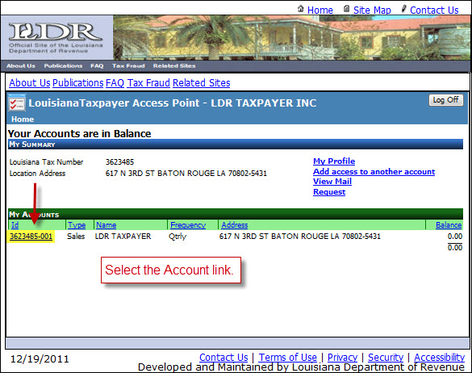
Select the account for which you are requesting a new or renewal resale certificate.
Follow the instructions to complete the renewal process.

Slide 9
Once the application is completed, be sure to hit the “Submit Request” button.
Make a note of the confirmation number in case there is a problem.
Processing of the application usually takes 2 – 3 business days.

Slide 10
You can check the status of the application in LaTAP.
Once the stage says “Success”, the resale certificate is available for printing. The LDR-printed certificate should arrive by mail within 7 – 10 business days.

Slide 11
Pop Up Blockers
must be disabled
BEFORE
you can print the Resale certificate.

Slide 12
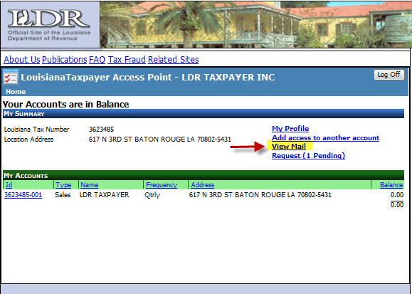
When the renewal process is successful, the Sales Tax Resale Certificate is placed on the taxpayer's LaTAP View Mail page.
It is now available for printing.
Click the View Mail option to access the Resale Certificate.

Slide 13
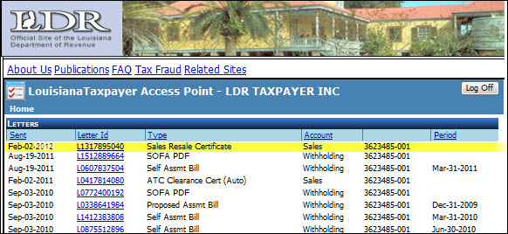
Double click on the Letter Id link for the Sales Resale Certificate to display the cover letter with the attached certificate.

Slide 14
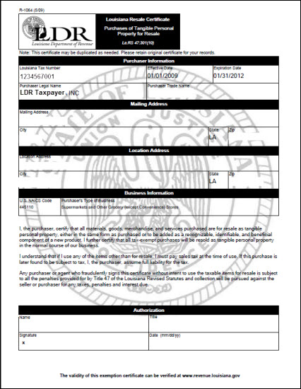
Scroll down the page to view the resale certificate.
You can print the certificate at this point.

Slide 15
MULTIPLE LOCATIONS
For businesses with multiple locations that file a consolidated sales tax return, the Main or Master Account application should be completed under the consolidated account number utilized to file your sales tax returns.
The contact and business information you enter on the master application will be saved and you will not have to complete these sections again.

Slide 16
MULTIPLE LOCATIONS
After completing your main request using the consolidated account location, you must complete a new or renewal request for each of the other business locations. Your application date should be based on the earliest certificate expiration date of the members of the consolidation. Only those requests for certificates that will expire within the next 60 days will be renewed.
Once your application is processed and approved, all locations you have entered will have the same effective and expiration dates on the Resale Certificate from this point forward.

Slide 17
WHY DIDN’T I GET A RENEWAL?
DID YOU FILE
A
SALES TAX RETURN?
Notes:
Only those taxpayers that file sales tax returns will be renewed. LDR reviews the sales tax activity of the applicant for the past 12 months. If no returns have been filed, the resale certificate will not be renewed.

Slide 18
USEFUL LINKS
To apply or renew resale applications:
www.ldrtap.rev.louisiana.gov
To quickly reprint a resale certificate without going through LATap:
www.revenue.louisiana.gov/sections/business/resalecertificate
To verify the validity of a resale certificate:
www.revenue.louisiana.gov/sections/business/resalecertificate
Notes:
To reprint a valid resale certificate, you can go through the LDR website at revenue.louisiana.gov/resalecertificate. You have to create a user account and password to access the resale certificate. To avoid this, just set up an account in LATap and all account information including the resale certificate will be available.
You can also verify resale certificates on the LDR resale certificate page. It is updated nightly so new taxpayers are added on a daily basis.

Slide 19
Questions?

