Slide 1
Refund Card Updates
Presented by Bobbie Swafford Customer Service Division Louisiana Department of Revenue

Slide 2
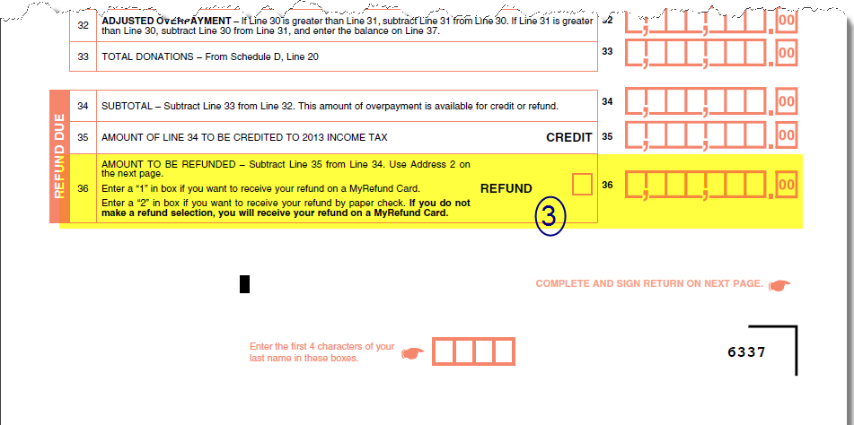
Refund Options

Slide 3
Louisiana Citizens Insurance Credit
LDR has created an application to file the R-540INS - Refund Request of LA Citizens for Property Insurance-Individual electronically on our website for 2013.
Refunds can be issued direct deposit, paper check or MyRefund card
Paper returns will have the option of check or MyRefund card.

Slide 4
Questions?

