Slide 1
Office Audit Division ~Credits and Payments~
Annual Liaison Meeting
January 16, 2014
Dawn Bankston &
Michelle Galland

Slide 2
Credits & Refunds
Agenda topics
Documentation for Credits
Refund Turnaround Time
Tax Credit Registry
Invalidation of Certified Credits
Tax Credits Pertaining to Prescribed Periods

Slide 3
Documentation for Credits
Instruction booklets provide documentation requirements for credits.
No significant changes for 2013 tax period

Slide 4
Documentation for Credits
Composite Partnership Returns
Will now allow tax credits earned by the partnership
Submit documentation for Citizen’s credit and all other credits that require documentation on an income tax return
Electronic only for 2013 tax year and forward
Extensions will also be electronic only
Letter to go to taxpayers in January
Nonresident individual partners only
Resident partners cannot be included
No payments will be made by the partnership on behalf of resident partners
Consider adjusting estimated payments

Slide 5
Documentation for Credits
Capital Gains Deduction
Federal 1040
Federal Form Schedule D - Capital Gains and Losses
Federal Form 4797 – Sales of Business Property
Taxpayer may receive a questionnaire and/or request for additional information
“Other” on Schedules E, F and G
Submit supporting documents for all “other”

Slide 6
Documentation for Credits
Transferrable Tax Credits
For credits certified on or before 12/31/13:
Certification letter from issuing agency, and/or Transfer documents
Form R-10611 is available for the Motion Picture Investment Tax Credit Schedule, and a similar schedule will be acceptable for most transferrable credits.
For credits certified on or after 1/1/14:
Form R-6140 “Credit Utilization Form” and
Form R-6135 “Credit Registration Form”
Note: All credit transfers and applicable transfer fees are now submitted to LDR effective 6/21/13 (Revenue Information Bulletin No. 13-021)

Slide 7
Documentation for Credits
Wind & Solar Credit
Form 1086 and paid invoices
Distinction between leased vs. purchased and date placed in service determine maximum credit amount
Documentation for ‘placed in service date’ such as the net metering connection agreement
See Revenue Information Bulletin 13-026 Solar Energy Systems Tax Credit, for more information about the changes

Slide 8
Documentation for Credits
Submitting Documents for E-Filed Returns
Modern E-filing (MEF) allows for the submission of PDF files with e-filed returns.
E-Fax number: (225) 231-6221
Include taxpayer’s name, account number, and tax filing period on the top of the first page of the fax.
Send separate fax for each taxpayer. An electronic image of the fax will be stored in the taxpayer’s account.

Slide 9
Refund Turnaround Time
Individual Income Tax Refund Turnaround FYE13
29 day average turnaround for electronic returns
37 day average for all returns
Business Tax Refund Turnaround FYE13
59% of all business tax refunds issued within 60 days
Average turnaround time varies greatly by tax type, source of refund and dollar amount
# Refunds | <= 30 days | 31-60 days | 90+ days
1,561,447 | 71.6% | 19.9% | 5.1%

Slide 10
Avoid Refund Delays
File electronically and attach supporting documentation
Use correct social security number
Use correct mailing address
Check for math errors
Name consistency - always file with the same names (first, middle, last) in the same order each year.
Correct estimated payments and credit carry forwards reported compared to LDR records.
Amended returns correctly - should be completed as if no other return was ever filed for the period.

Slide 11
Tax Credit Registry
Revenue Information Bulletin No. 14-005
For transferable credits certified on or after January 1, 2014
Recording a transferable tax credit granted by a state agency
Certifying agency will submit certifications directly to LDR
LDR will issue “Credit Registration Form” (R-6135) to the party that earned the tax credit.
Credit Registration Form is proof of registration
The credit registration form will include a unique LDR State Certification Number valid for use by the credit earner only.

Slide 12
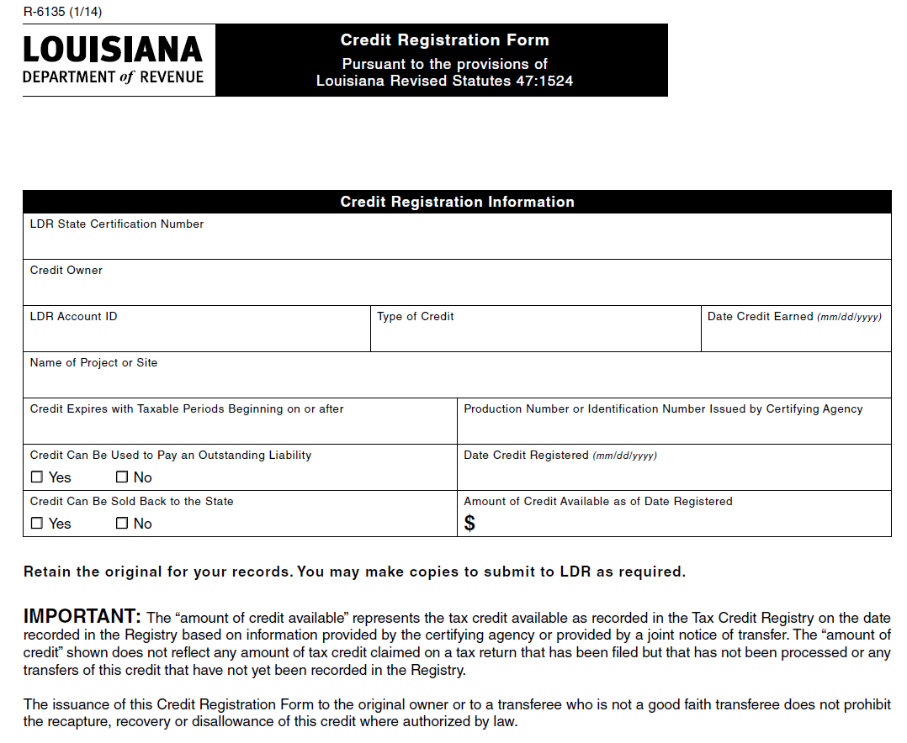

Slide 13
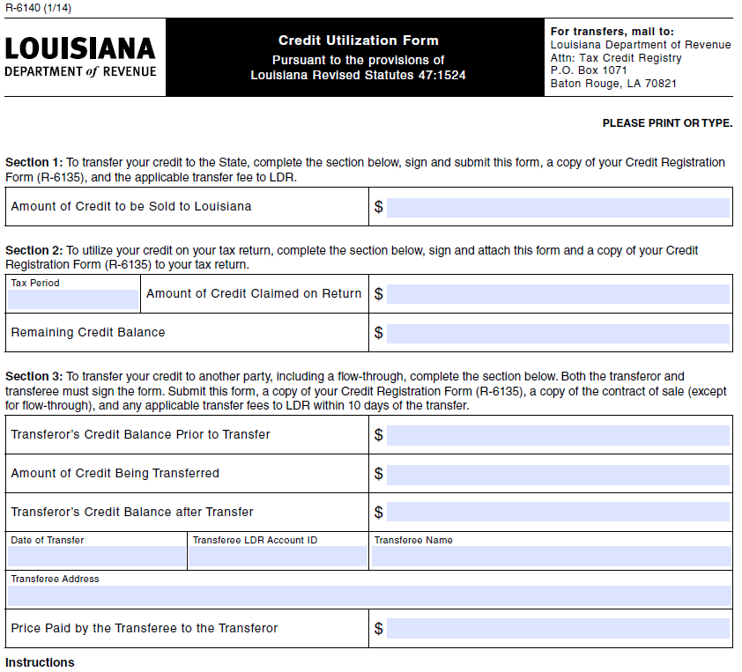

Slide 14
Tax Credit Registry
Transferring a recorded Motion Picture Investor credit to the State (‘sell back’)
The credit earner will submit a completed Credit Utilization Form (R-6140, Section 1), a copy of the Credit Registration Form (R-6135), and applicable transfer fee to LDR.
Claiming a recorded credit on a tax return
The credit owner will attach a completed Credit Utilization Form (R-6140, Section 2) and a copy of the Credit Registration Form (R-6135) to the tax return when claiming the tax credit.

Slide 15
Tax Credit Registry
Transferring a recorded credit to another party
The owner and buyer will jointly submit a completed Credit Utilization Form (R-6140, Section 3), a copy of the Credit Registration Form (R-6135), a copy of the contract of sale, and applicable transfer fee to LDR within ten days of the transfer.
A separate Credit Utilization Form will need to be completed for each transferee.
A transfer is not effective until it is recorded in the Registry.
After receiving the necessary paperwork and verifying the credit, LDR will enter the transfer into the Registry and issue a Credit Registration Form (R-6135) to the transferee as the new owner of the credit with a unique LDR State Certification Number valid for use by the named transferee.

Slide 16
Tax Credit Registry
Recording the flow-through of a transferable credit
The owner will submit a completed Credit Utilization Form (R-6140, Section 3), a copy of the Credit Registration Form (R-6135), and applicable transfer fee to LDR within ten days of the transfer.
A separate Credit Utilization Form will need to be completed for each partner or member.
After receiving the necessary paperwork and verifying the credit, LDR will enter the transfer into the Registry and issue a separate Credit Registration Form (R-6135) to each transferee as the new owner of the credit with a unique LDR State Certification Number valid for use by the named transferee.

Slide 17
Tax Credit Registry
Using a purchased credit to pay an outstanding tax liability
The owner will submit a completed “Transferable Credit Payment Voucher” (R-6170) and a copy of the Credit Registration Form (R-6135) to LDR.

Slide 18
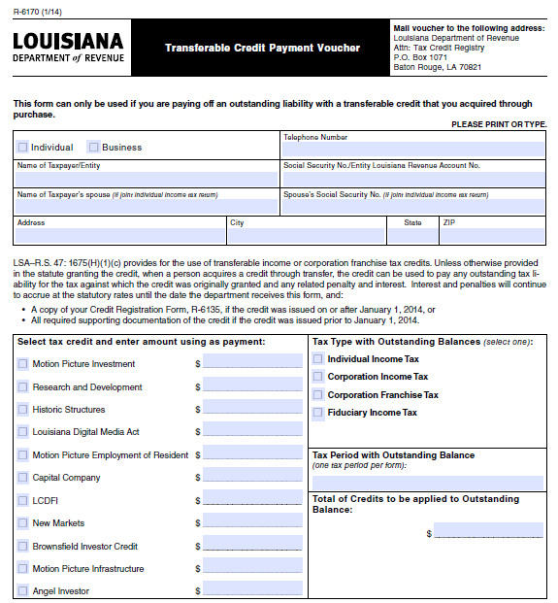

Slide 19
Tax Credit Registry
Requests of record ownership
The owner of the credit may submit a written request either by letter or email for a “Record Owner Report.” The request must contain the name and address of the owner and the LDR State Certification Number of the credit.
LDR will issue a “Record Owner Report” (R-6155) to the owner that will state the balance as of the date the report is issued along with LDR State Certification Number.

Slide 20
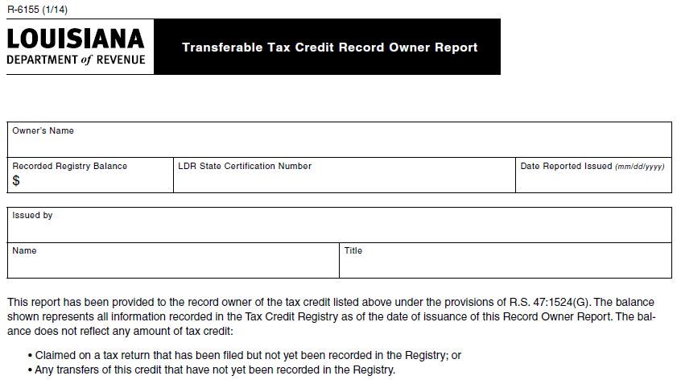

Slide 21
Tax Credit Registry
Contacting the Tax Credit Registry
Louisiana Department of Revenue
Attn: Tax Credit Registry
PO Box 1071
Baton Rouge LA 70821
Email: TaxCredit.Registry@la.gov

Slide 22
Invalidation of Certified Credits
There was a one instance where LED recalled their certification of credits that were previously certified.
LED has since re-instated these credits.
When the certification was recalled LDR disallowed the credits on the returns of those taxpayers that claimed the credits and issued proposed assessments. The credits have been re-applied to the affected accounts.

Slide 23
Tax Credits Pertaining to Prescribed Periods
Revenue Ruling No. 13-005
La. R.S. 47:1623(A)
“After three years from the 31st day of December of the year in which the tax became due or after one year from the date the tax was paid, whichever is the later, no refund or credit for an overpayment shall be made unless a claim for credit or refund has been filed with the secretary by the taxpayer claiming such credit or refund before the expiration of said three-year or one-year period.”

Slide 24
Tax Credits Pertaining to Prescribed Periods
“Refund or credit” refers to the ultimate disposition of an overpayment, either in the form of a refund to the taxpayer or a credit which is applied to a prior or subsequent tax year.
Overpayment is "a payment of tax, penalty, or interest when none was due; the excess of the amount of tax, penalty, or interest paid over the amount due; or the payment of a penalty that is later waived or remitted by the secretary, provided that the power of the secretary to refund overpayments shall be as prescribed and limited in this Section.” (R.S. 47:1621)

Slide 25
Tax Credits Pertaining to Prescribed Periods
Claim for credit or refund - for income tax purposes the filing of a return is the claim for refund.
In other words- return must be filed within three years from the December 31st of the year in which the tax became due, for a refund or credit of overpayment to be issued.
After the 3 years, a return filed with a tax credit, the tax credit can eliminate or zero out the tax for the period.

Slide 26
Questions?

