Slide 1
Tax Administration Division Louisiana Department of Revenue Presented by Michelle Galland

Slide 2
Individual Income 2012 New Year Changes

Slide 3
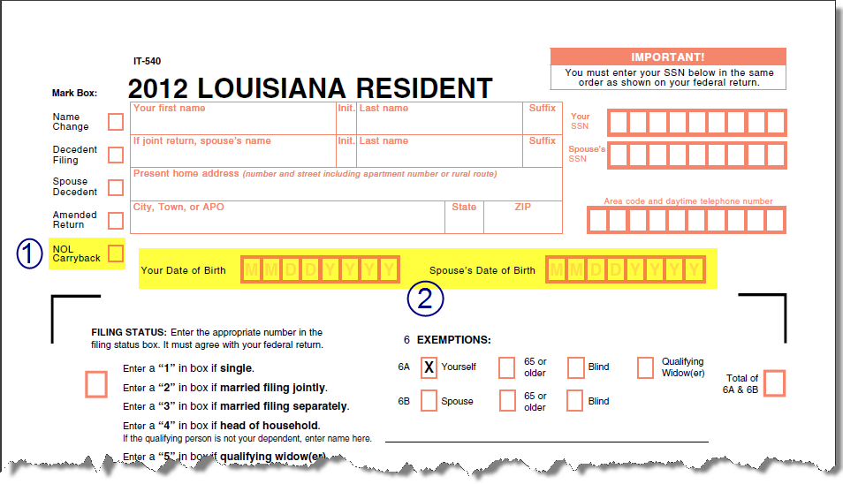
1. NOL Carryback
2. Date of Birth

Slide 4
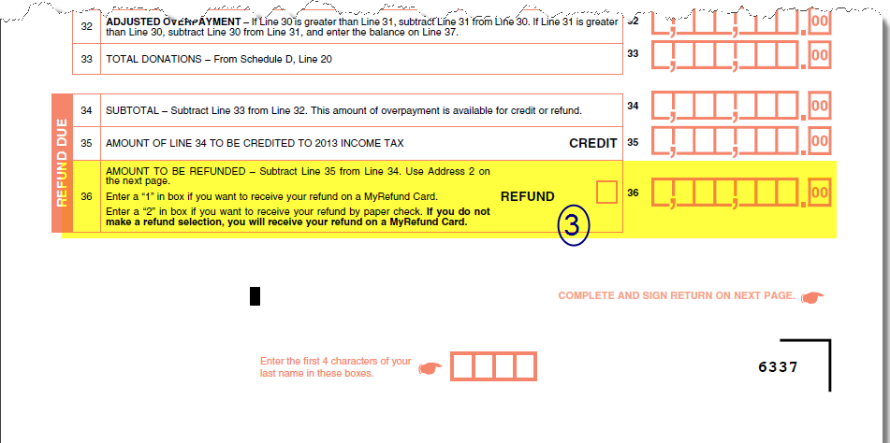
3. Refund Options

Slide 5
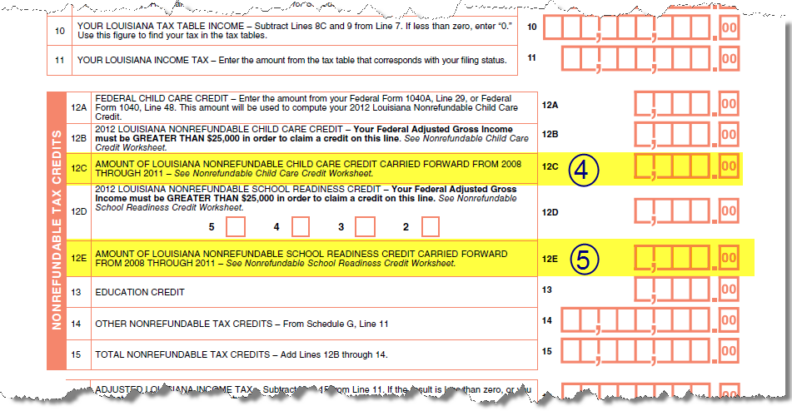
4. Child Care Credit Carried Forward
5. School Readiness Credit Carried Forward

Slide 6
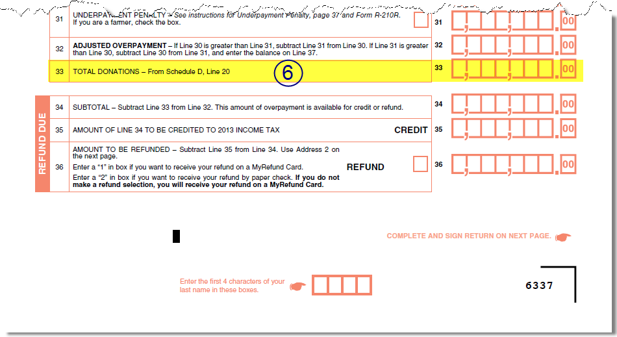
6. Schedule D – Donations
new donations added to the return

Slide 7
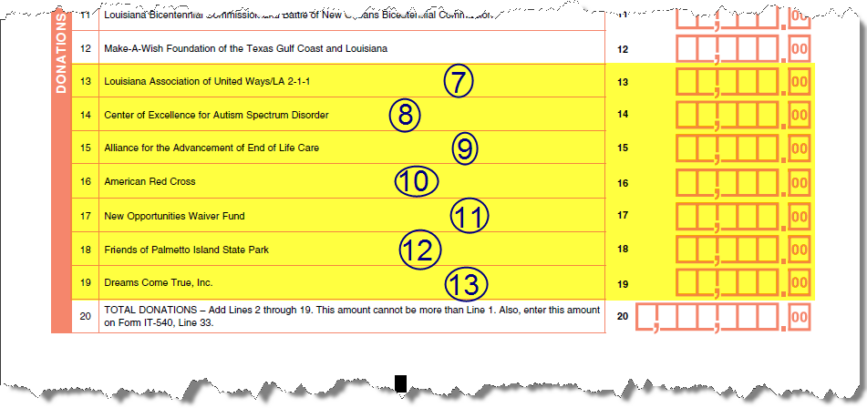
6. Schedule D – Donations
7-13. New donations

Slide 8
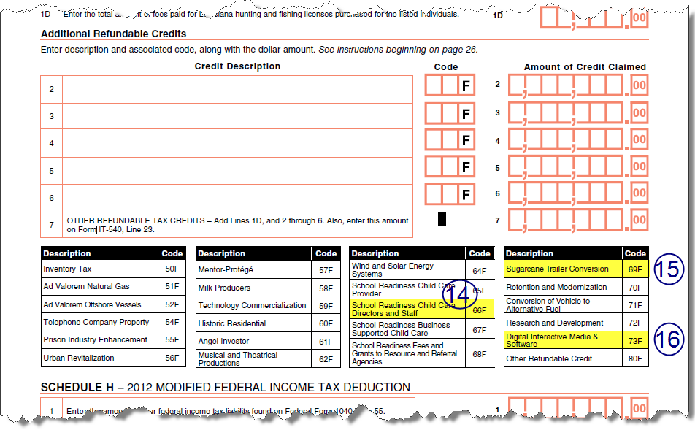
14-16. Refundable Credits

Slide 9
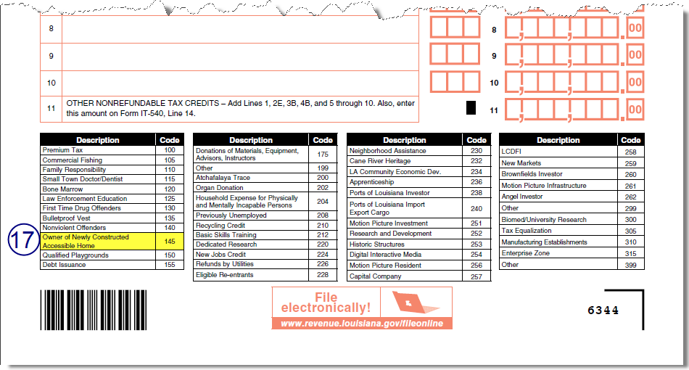
17. Nonrefundable Credits

Slide 10
Owner of Newly Constructed Accessible Home Credit
For 2012 Tax Year and forward, R-1089 will be used as documentation for the credit. Is currently available on our website under “Tax Returns” for Individual Income tax.

Slide 11
Extensions for Partnerships & Fiduciary Tax Returns
In past R-6466 was used to request an extension to file the Partnership Return or the Fiduciary Tax Return.
For 2012 Tax Year and forward:
R-6466 will be used for Fiduciary Tax Return.
R-6463 will be used for Partnership Return. This is a new form.
R-6467S will still be used for Composite Partnership Return.

Slide 12
Electronic Filing Mandates

Slide 13
Electronic Filing Mandates for Individual Income Tax Returns
Any tax preparer that prepares more than 100 Louisiana individual income tax returns must electronically file 90 percent of those returns due on or after January 1, 2012 (R.S. 47:1520).
A nonresident professional athlete who earned income as a result of services rendered within Louisiana must file Form IT-540B-NRA electronically (Rule LAC 61:III.1527).
A resident individual who is a professional athlete is also required to electronically file their Louisiana income tax return, IT-540 reporting all of their income (Rule LAC 61:III.1527).

Slide 14
Electronic Filing Mandates for Withholding
Businesses required to withhold and to submit income taxes on gaming winnings (Rule LAC 61:I.1525):
Must pay withholding and file L-1 electronically.
Professional Athletic Teams (Rule LAC 61:I.1525):
Must file L-1 for 2010 and forward.
Any taxpayer required to pay electronically (R.S. 47:1520):

Slide 15
Electronic Filing Mandates for Withholding Tax Statements
Businesses required to withhold and to submit income taxes on gaming winnings (Rule LAC 61:I.1525)
Professional Athletic Teams (Rule LAC 61:I.1525)
Withholding L-3 (Rule LAC 61:I.1515):
Employers that file 150 or more employee withholding statements due on or after January 1, 2012.
Employers that file 100 or more employee withholding statements due on or after January 1, 2014.
Employers that file 50 or more employee withholding statements due on or after January 1, 2016.

Slide 16
Other Electronic Filing Mandates
Sales Tax Returns for taxpayers located in a Tax Increment Financing District (Rule LAC 61:III.1515)
Hotel and Motel Sales Tax Return, Form R-1029DS (Rule LAC 61:III.1517)
Statewide Hotel/Motel Sales Tax Return, Form R-1029H/M (Rule LAC 61:III.1523)
New Orleans Exhibition Hall Authority Additional Room Occupancy Tax and Food and Beverage Tax Return, Form R-1325(Rule LAC 61:III.1519)
Louisiana State and Parish and Municipalities Beer Tax Return, Form R-5621 (Rule LAC 61:III.1521)
Severance Tax—Oil or Gas (Rule LAC 61:III.1525)

Slide 17
Electronic Payment Mandates for Business Taxes
R.S. 47:1519 and Rule LAC 61:I.4910
The tax due in connection with the filing of any return, report or other document exceeds $5,000.
A taxpayer files tax returns more frequently than monthly, and during the preceding 12-month period, the average total payment exceeds $5,000.
A company files withholding tax returns and payments on behalf of other taxpayers during the preceding 12-month period and the average total payments for all tax returns filed exceed $5,000.

Slide 18
Electronic Filing Mandate for Extension Requests

Slide 19
Electronic Filing Mandate for Extension Requests
LAC 61:III:2501 - Individual Income Tax Filing Extensions notice of intent issued 10/20/2012
LAC 61:III:2503 Corporation Income and Franchise Tax Filing Extensions notice of intent issued 10/20/2012
Both rules should be adopted 1/20/2013

Slide 20
Electronic Filing Mandate for Extension Requests
Requests must be made on or before due date of return
Mandate is for all taxpayers requesting an extension
Hardship exception for individual income tax only will be handled by Special Programs.

Slide 21
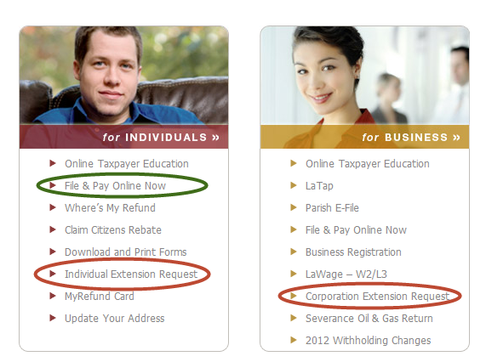
Electronic Extension Requests
LDR’s website
File Online application (Individual Income tax only)
the Online Extension Filing application
Bulk extension filing application (click on Tax Professional)

Slide 22
Electronic Extension Requests
LDR’s IVR phone system
Call 225-922-3270 or 888-829-3071. For extension request, select option #3. Once selected, individuals will then select option #1 and corporations option #2.
Need SSN for individual; the LA account number for Corp
Tax preparation software that supports the electronic filing of extensions

Slide 23
Payments & Electronically Filed Extensions
For 2012 Tax Year and forward, to make a payment when the extension request has been electronically filed:
R-2868V for individual income tax.
R-6463 for corporation income tax.
Notes:
Don’t know if we will mandate payments electronically yet

Slide 24
Louisiana Citizens Insurance Credit
Can now file the R-540INS at www.Revenue.louisiana.gov/fileonline
Can file 2009 – 2013
Can direct deposit

Slide 25
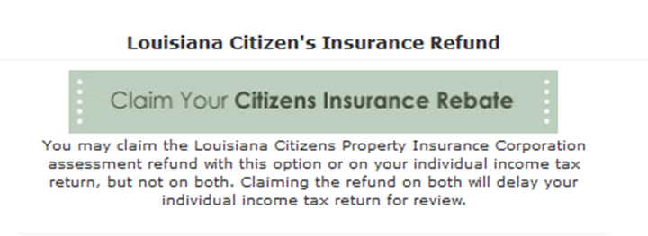
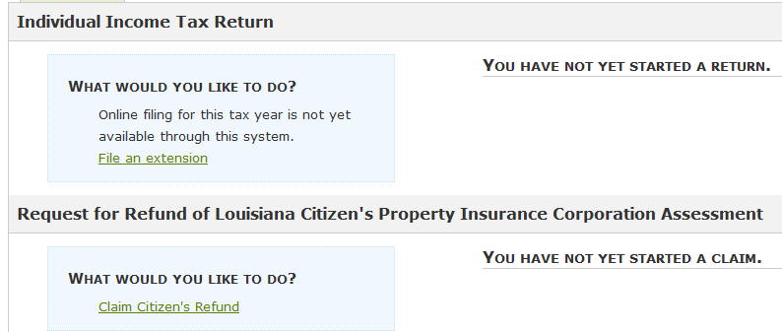
Louisiana Citizens Insurance Credit

Slide 26
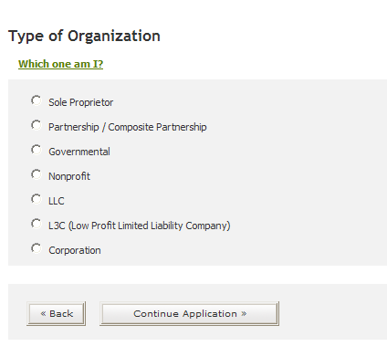
Online Business Registration
We have expanded who can register:
Notes:
Partnership will be registered for composite if needed.
LLC- will need to select how you file with IRS, corporation or partnership.

Slide 27
Composite Partnership Return
Act 580 (HB 377) enacts R.S. 47:201.1(F) to provide for claiming tax credits earned by a partnership on the composite partnership return on behalf of nonresident individual partners.
The Act also provides for overpayment to be made to the partnership and mandates the electronic filing of the composite return.
Effective for taxable periods beginning on or after January 1, 2013.

Slide 28
Questions?

