Slide 1
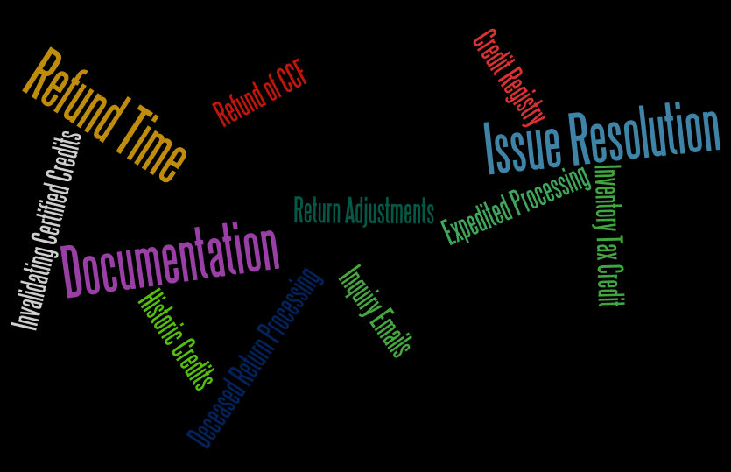
Office Audit Division
2015 Liaison Meeting
dawn Bankston

Slide 2
Status of Tax Credit Registry
Implemented quick solution 1/1/14
Rule drafted, should be released soon
2014 activity:
209 projects
311 certifications
3,273 transfers
4,759 returns claiming transferable credits received

Slide 3
Circumstances for LDR Invalidating Certified Credits
LED once invalidated credits that were previously certified after the certifying CPA withdrew their certified audit report. This case involved fraud allegations.

Slide 4
Historic Rehabilitation Credits
Final determination of the amount of credit is now handled by LDR
RIBs 14-007, 14-007A
>$500K requires CPA certification
<$500K allows itemized list, certain receipts, related party transaction disclosure and notarized statement
122 projects received in CY2014

Slide 5
Time Necessary to Process Refund Claims
Individual Income Tax Refund Turnaround FYE14
28 day average for electronic returns
38 day average for all returns
Business Tax Refund Turnaround FYE14
59% of all business tax refunds issued within 90 days.
Average turnaround time varies greatly by tax type, source of refund and dollar amount
# Refunds | <= 30 days | 31-60 days | 61-90 days | 91+ days
1,588,067 | 77.5% | 14.7% | 2.5% | 5.3%

Slide 6
Suggestions for Expedited Return Processing
File electronically with supporting documentation attached
Name consistency - file with the same names (first, middle, last) in the same order each year
Use correct figures for credit carry forward, estimated payment and extension
Amended returns as if no other return was ever filed for the period. Amended return replaces the original.

Slide 7
Return Documentation: General Requirements
Instruction booklets provide documentation requirements
No significant changes
E-Fax number: (225) 231-6221 – SLOW, MANUAL PROCESS
Include taxpayer’s name, account number, and tax filing period on the top of the first page of the fax.
Send separate fax for each taxpayer. An electronic image of the fax will be stored in the taxpayer’s account.

Slide 8
Return Documentation: Inventory Tax Credit
Attach copies of assessments and canceled checks for the first three years claimed. If applicable, include partner allocation and K-1
After three years, attach Form R-10610 only, unless there is a significant increase in amount.

Slide 9
Return Documentation: Transferrable Credits
100% stopped for review before return is posted to the account
Transferrable Tax Credits
For credits certified on or before 12/31/13:
Certification letter from issuing agency, and/or Transfer documents
Form R-10611 is available for the Motion Picture Investment Tax Credit Schedule, and a similar schedule will be acceptable for most transferrable credits.
For credits certified on or after 1/1/14:
Form R-6140 “Credit Utilization Form” and
Form R-6135 “Credit Registration Form”

Slide 10
Return Documentation: Misc.
Capital Gains Deduction
Federal 1040
Federal Form Schedule D - Capital Gains and Losses
Federal Form 4797 – Sales of Business Property
Taxpayer may receive a questionnaire and/or request for additional information
“Other” on Schedules E, F and G
Submit supporting documents for all “other”

Slide 11
Return Adjustments Preceding Data Requests
Tin, Inc. decision ➔ certified refund reduction/denial letters
Missing documentation ➔ 3 letters:
Certified refund denial/reduction letter (1 page max)
Manual request for documentation (if can’t fit on 1 page)
System generated “recomp” showing line by line changes
Upload attachments with e-filed returns
We have submitted a research task to find out if we can create a certified letter with delay print (post date) and/or increase to allow 2 pages.

Slide 12
Overpayments Refunded Rather than Credited, as Requested
Do not cash unexpected refund checks
Return check to LDR with a request to ccf.

Slide 13
LDR Lack of Acknowledgement of Issue Resolution
If taxpayer responds to a request for documentation, the LDR employee should follow-up IF the documentation provided is not sufficient.

Slide 14
Deceased Taxpayer Return Processing
Submit a copy of the deceased taxpayer’s death certificate.
This is requested to close the taxpayer’s account and prevent fraudulent use of social security number.
If need to change payee on refund, also submit:
Form R-6642 (IT-710) “Statement of Claimant to Refund Due on Behalf of Deceased Taxpayer” with the deceased taxpayer’s death certificate.

Slide 15
Tax Practitioner Refund Inquiry Emails
TaxPractitionersRefund.Inquiry@la.gov
Allow 3 business days

Slide 16
Questions?

